Slide 1
CSC 101 Applied Physics Spring 2023
Dr. Syed Irfan Sohail

Slide 2
Second part of
(CSC101 Applied Physics)
is
Engineering Mechanics
Statics and Dynamics
Recommended book:
Engineering Mechanics
Statics and Dynamics
By R.C. Hibbeler, 11th Edition or 12th Edition
Questions from previous lecture-17
You can interact online on Google Classroom

Slide 3
Engineering Mechanics
Ch-2: Force Vectors
Topic in previous lecture:
We studied about Scalars and Vector quantities, then we saw how to represent the Vector, through its magnitude and direction.
Then we studied the parallelogram law and triangle law and we observed how vectors can be added, subtracted and multiplied etc.
We also solved two problems regarding vectors

Slide 4
Engineering Mechanics
Ch-2: Force Vectors
Topic in this lecture:
Example problems about force Vectors

Slide 5
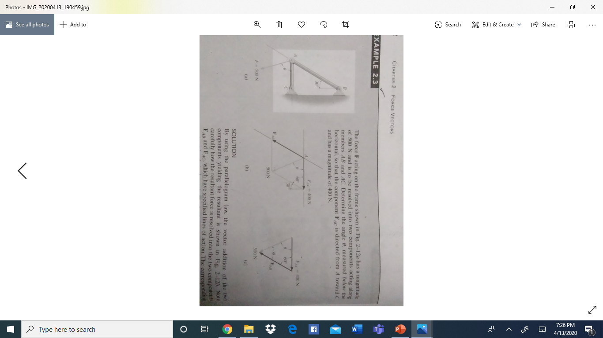
Example 2.3/page 22, 11th edition

Slide 6
Example 2.3/page 22, 11th edition

Slide 7
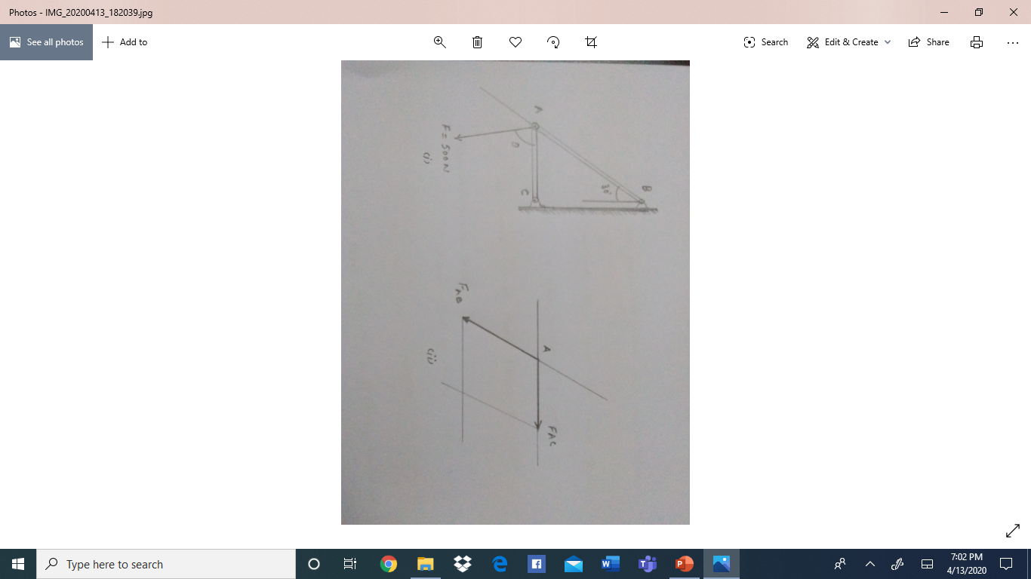
Example 2.3/page 22, 11th edition

Slide 8
Example 2.3/page 22, 11th edition

Slide 9
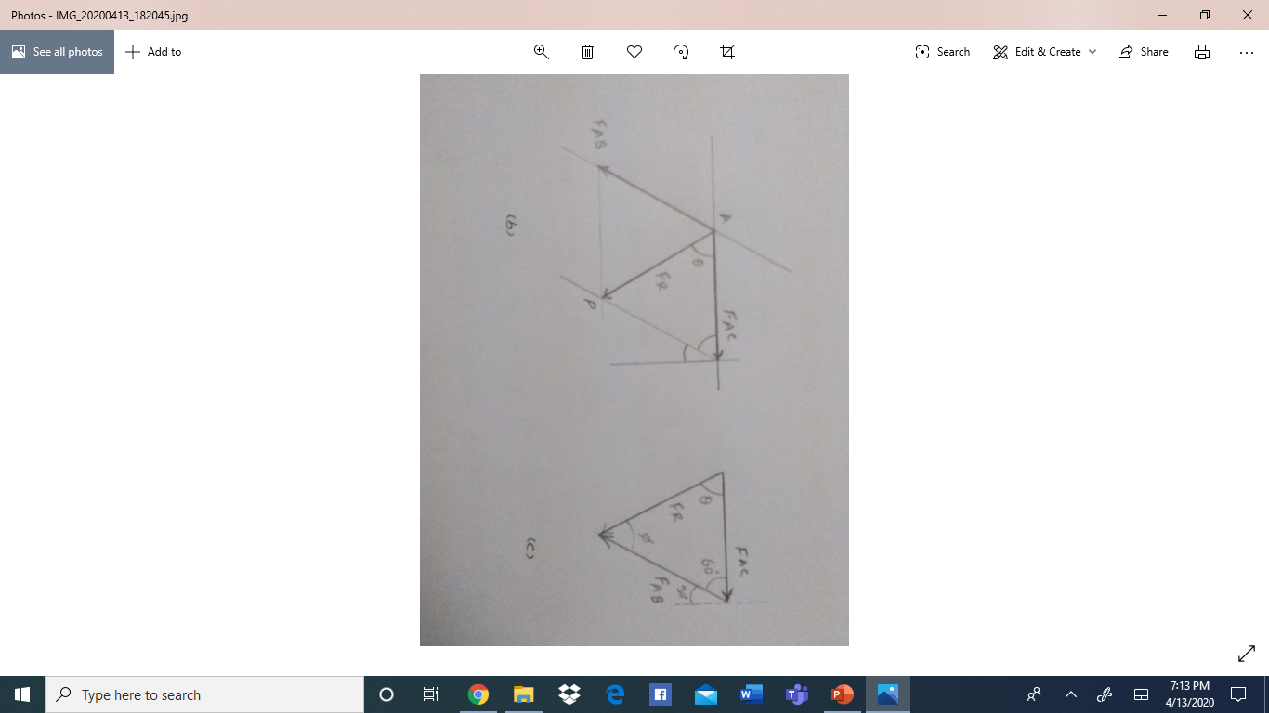
Example 2.3/page 22, 11th edition

Slide 10
Example 2.3/page 22, 11th edition

Slide 11
Example 2.3/page 22, 11th edition
Parallelogram law
By Using the Parallelogram law, the resultant can be obtained
By using our three basic steps:
From head of first vector draw a parallel line
From the head of second vector draw a parallel line
From the tails of two vectors extend line that meets at the point of
Intersection obtained in i) an ii)

Slide 12
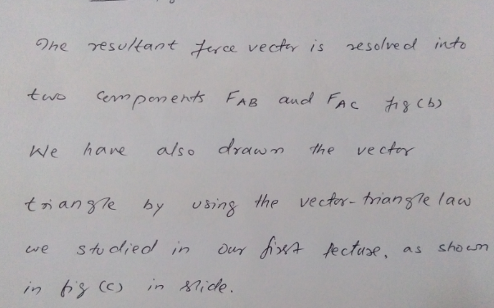
Example 2.3/page 22, 11th edition

Slide 13
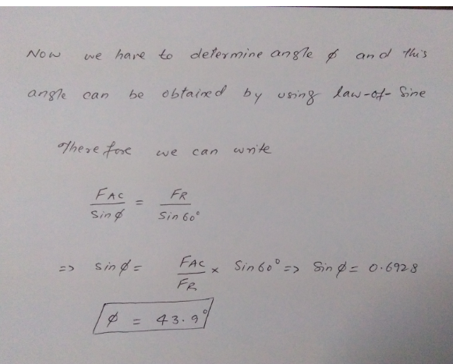
Example 2.3/page 22, 11th edition

Slide 14
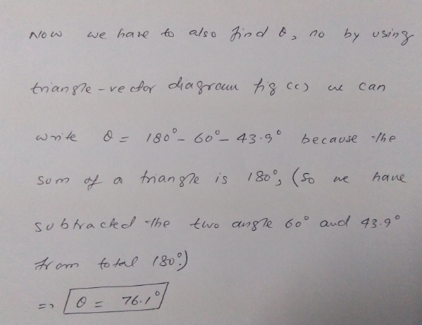

Slide 15
So we have obtained the angle of the resultant Fr that makes with the
Vector FAB and this angle is 43.9 degrees
Example 2.3/page 22, 11th edition

